Slide 1
Design Patterns
The State

Slide 2
Title slide
Text Here
Bullet point formatting
Color wheeee
Other color whooo

Slide 3
Application state
Current knowledge

Slide 4
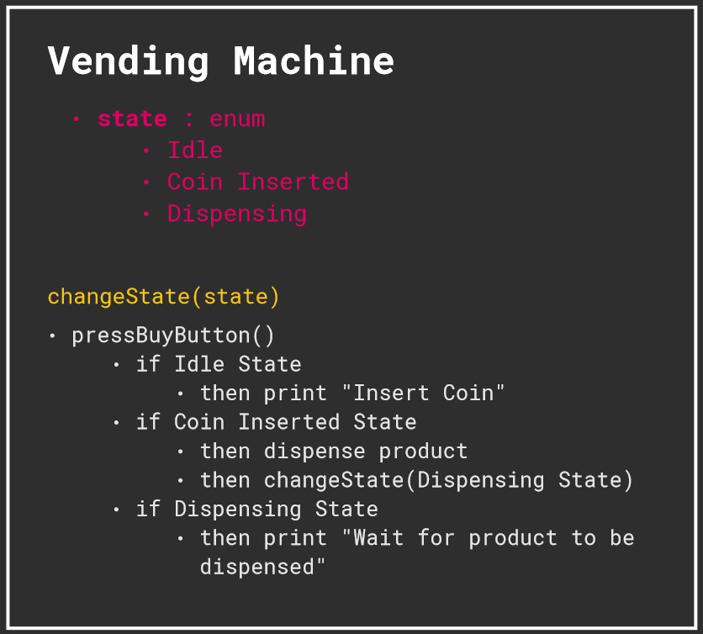
Vending machine example

Slide 5
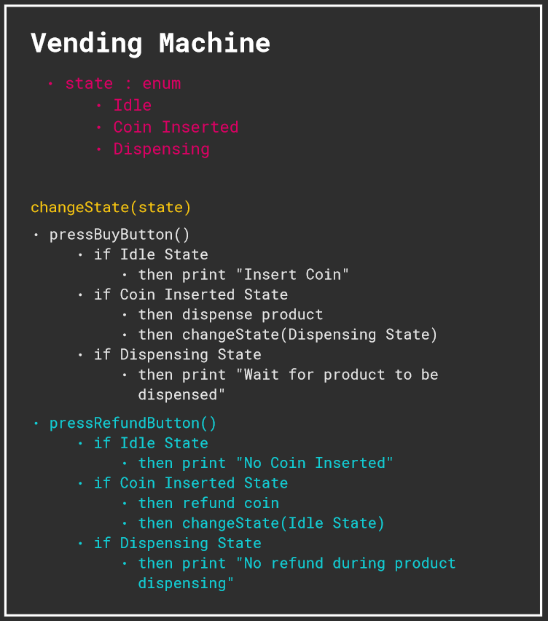
Adding one method

Slide 6
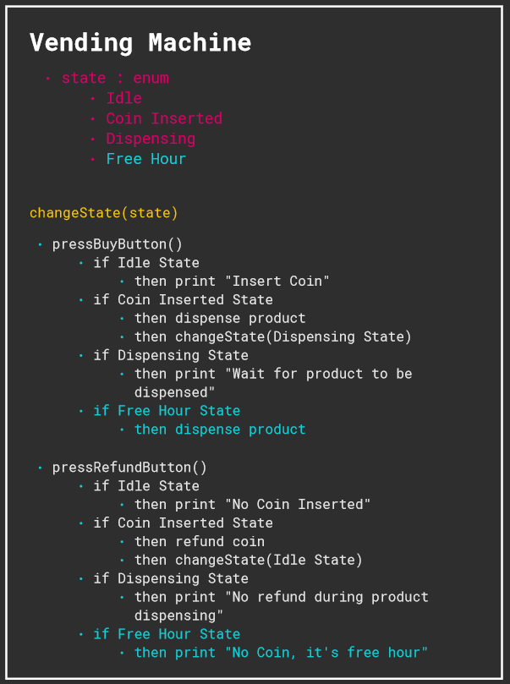
… and another state

Slide 7
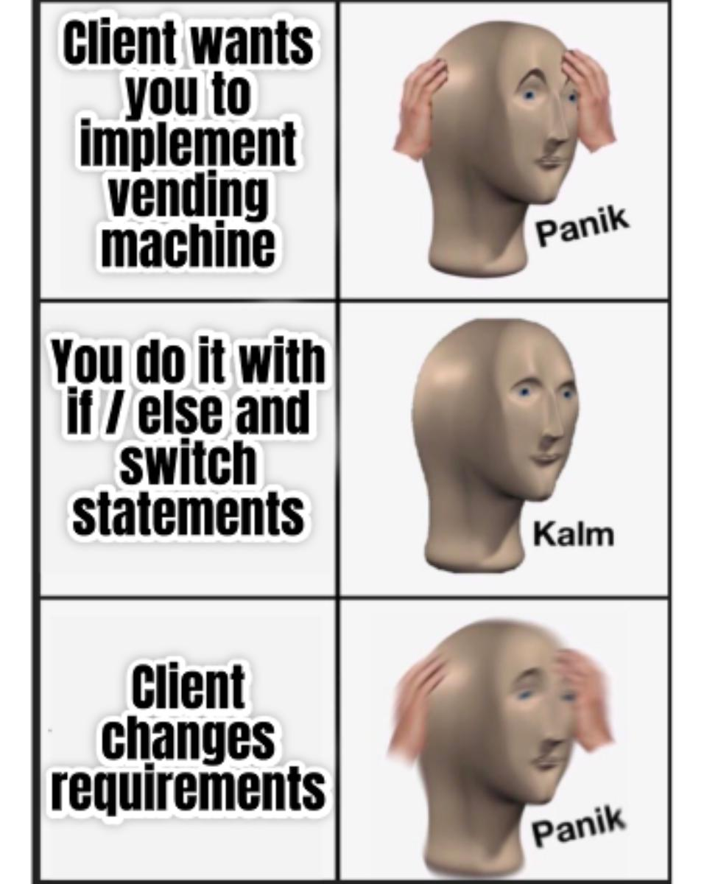
Managing complex states in one class
Nested if / else
Hard to maintain code
Very hard to scale

Slide 8
Application state
Using design pattern

Slide 9
State definition goes here ?
Text Here
Bullet point formatting
Color wheeee
Other color whooo

Slide 10
Refactoring
Using the State pattern

Slide 11
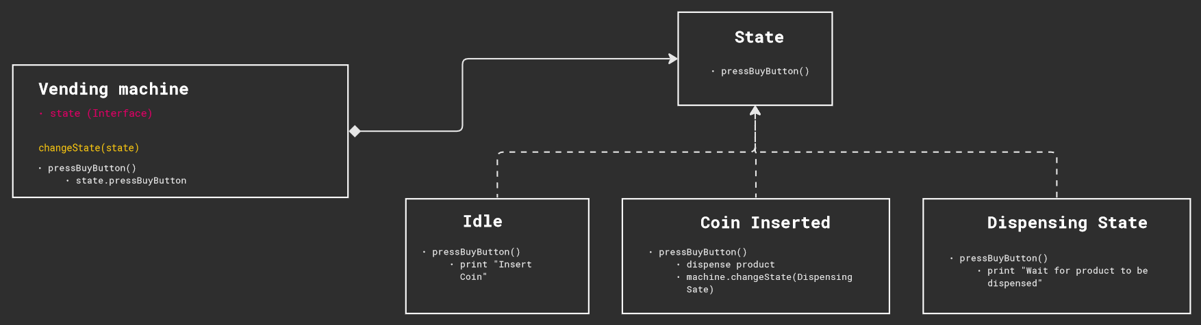
Refactoring with state: initial situation

Slide 12
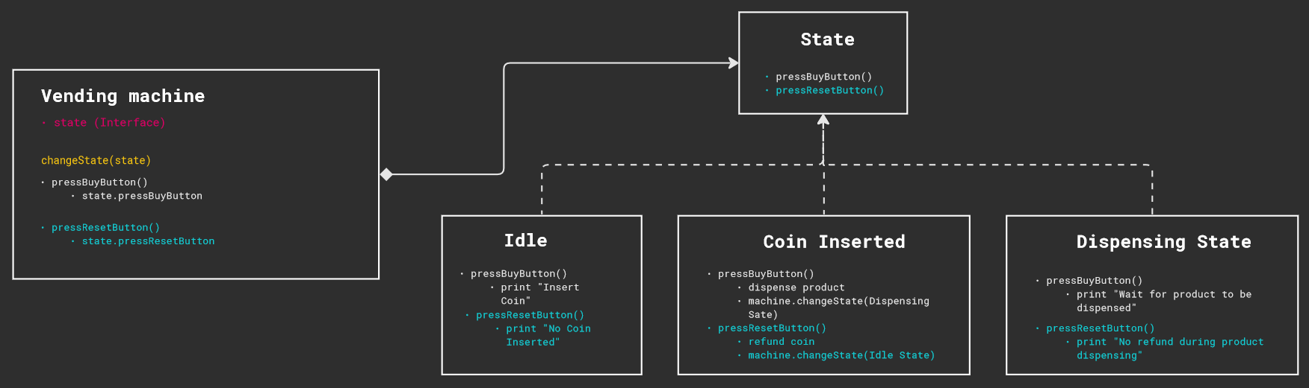
Refactoring with state: adding a method

Slide 13
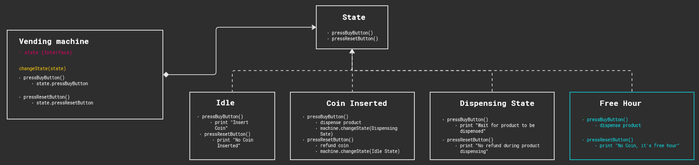
Refactoring with state: adding a state

Slide 14
Pros & Cons

Slide 15
Pros
Cons
Text Here
Bullet point formatting
Text Here
Bullet point formatting

Slide 16
Thank you!
Any question?

Slide 17
Title slide
template

Slide 18
Title slide - template
Text Here
Bullet point formatting
Color wheeee
Other color whooo

